Slide 1


Mining Rescue
Arduino with C Code
ELECTRICAL ENGINEERING AND COMPUTER SCIENCE, COLLEGE OF ENGINEERING AND PHYSICAL SCIENCES
Notes:
Updated 19 Jun 2024 by Noah Mulvaney

Slide 2
Scenario
What would happen if a mine were to collapse and coal miners were trapped in darkness?
How would you find and rescue the miners in the dark?
You could use thermal/infrared cameras, but they are expensive and use a lot of power.
We will build and code an ultrasonic sensor attached to a servo motor to scan the darkness for stranded miners.

Slide 3
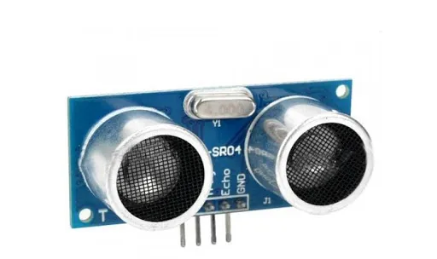
What is an ultrasonic sensor?
The sensor sends out ultrasonic sound waves (above the range of human hearing) and times how long it takes for them to be reflected.
We can calculate the distance between the sensor and an object based upon this timing.
Notes:
https://commons.wikimedia.org/wiki/File:Sonar_Principle_EN.svg

Slide 4
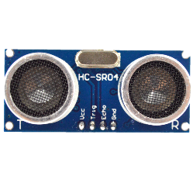
Project Concept
We will connect an ultrasonic sensor to
a servo motor so we can rotate it to
scan an area. We will scan from 0° to
180° in increments of 15° when we press
the button.
If we detect an object, we will print the position of the servo (an angle) and the distance from the sensor and light up the LED. We could plot these values on polar graph paper to visualize the location of the miners.

Slide 5
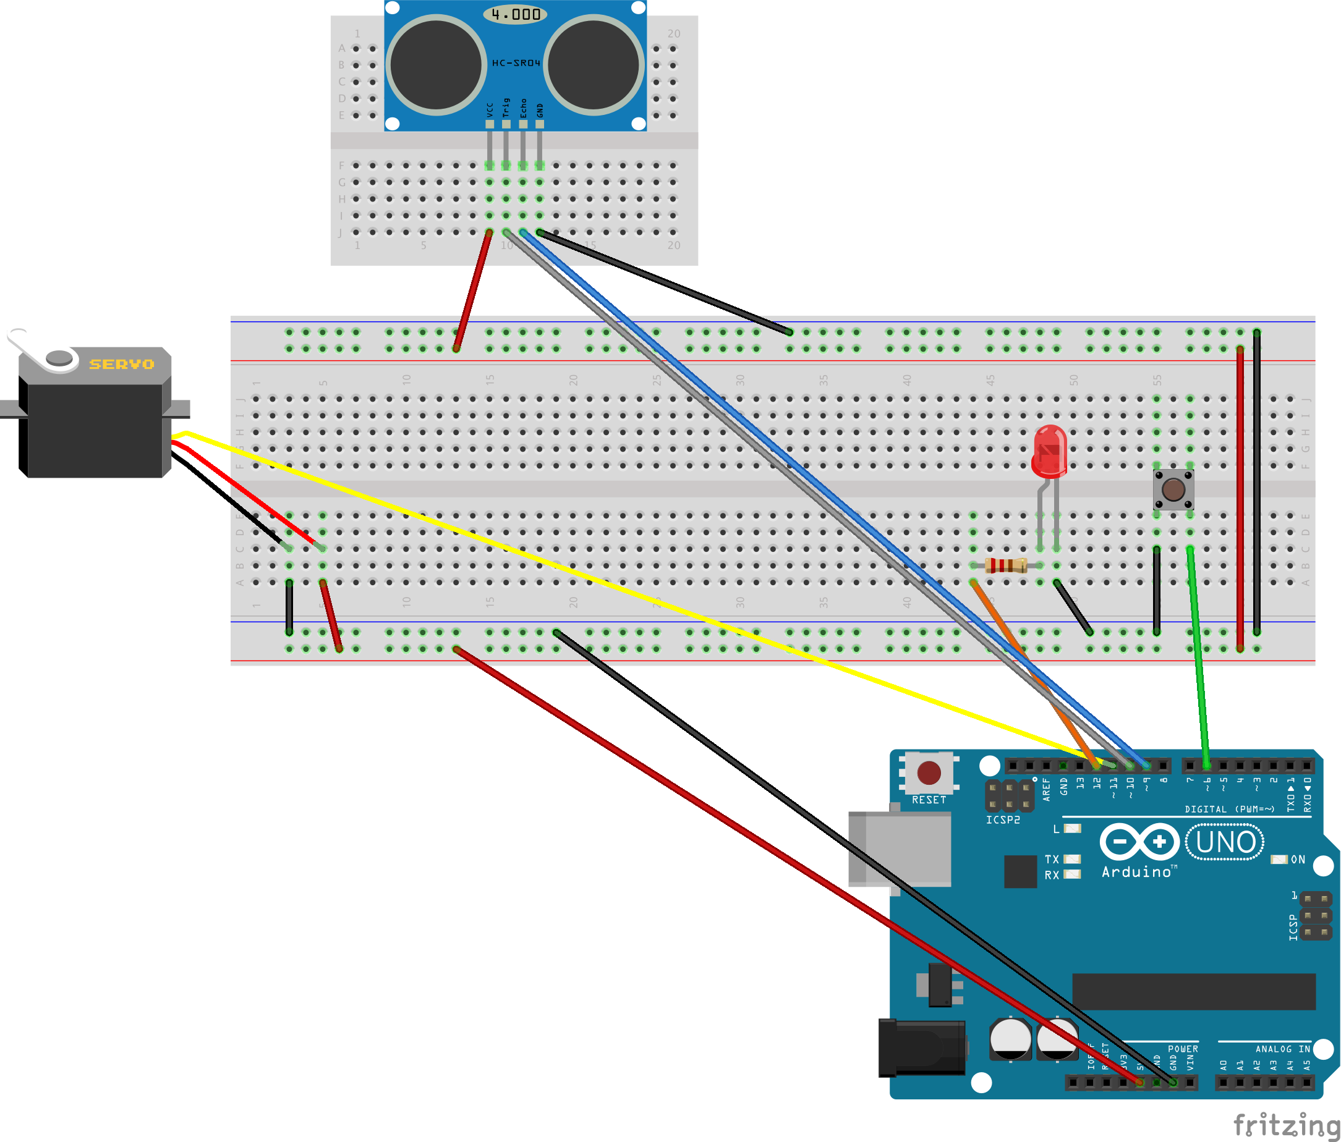
Circuit Diagram
Build this circuit with your
  SG90 Servo Motor
  Ultrasonic Sensor
  Red LED with 220Ω Resistor
  Pushbutton
Now tape the small breadboard
to the servo horn (the white arm)
10
9
11
12
6

Slide 6
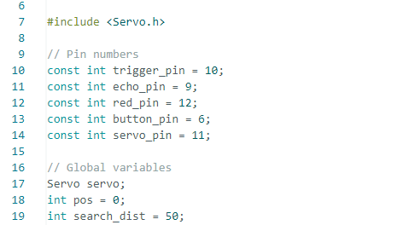
Arduino Code

Slide 7
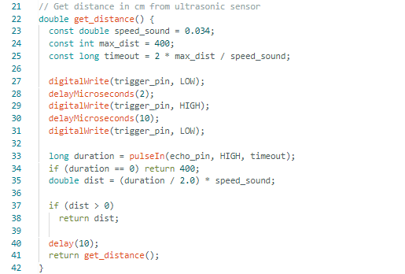
Arduino Code

Slide 8
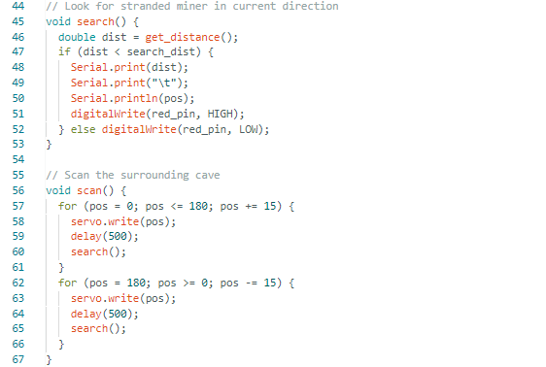
Arduino Code

Slide 9
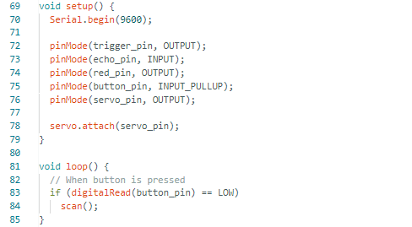
Arduino Code

Slide 10
Test the Program
Press the pushbutton to begin scanning.
Now experiment scanning the area around you. Adjust the search_dist and observe its effects.

